Slide 1
Introduction to Open Banking (for Advisors)

Slide 2
What is Open Banking?
Open refers to the sharing of financial information and data between banks and third-party financial service providers, at the direction of and with the explicit consent of the account holders.
Clients share their financial data more securely with authorized third-party providers like yourself via our technology platform.
Data includes banking and investment account including transactions, account balances, and other relevant financial information.
Connection provides more reliable access to the data by bypassing disruptions caused by broken connections and changed or one-time passwords.
Uninterrupted access to critical information you need, so you can offer advice that’s in the best interest of your clients and perform back-office processes like performance reporting.

Slide 3
Open Banking Benefits
Advisor Benefits
Client/Consumer Benefits
Open Banking establishes direct connections between the banks and ByAllAccounts via APIs
Once established, the connection:
Eliminates the need for screen scraping
Client only enters their credentials at their financial institutions
Results in quicker connects
Reduces connectivity disruptions
Consumers are redirected to their bank site to grant access to the data to third-parties.
Once Established, the connection:
Eliminates the need to share credentials with third-parties
Bypasses disruptions caused by multi-factor authentication
Allows account owners to manage access to their data at each of their institutions

Slide 4
Open Banking Process
Process | Benefits
Step One: Account holders are redirected to their Financial Institution site to login and authorize access to their accounts | Improved security and transparency for the account holder ByAllAccounts will no longer require user login credentials to access data Banks manage credential security Account holders can manage access to their accounts from their financial institution’s security center
Step Two: ByAllAccounts accesses account holder data via an API | Improved connectivity – quicker aggregation with less downtime Screen scraping is replaced with an API connection which means changes to the financial institution website will not “break” aggregation activity
Step Three Upon authorization, the Financial Institution shares a secure token with ByAllAccounts to aggregate the account holder’s data | Fewer interruptions in uptime Multi-factor authentication will not be required to establish ongoing account updates, reducing aggregation disruptions Changes to account holder credentials (password expirations for instance) will not “break” aggregation activity

Slide 5
Open Banking Conversion Process
1. Open Banking APIs Enabled for New Accounts
2. Migration of Existing Accounts to Open Banking APIs
Accounts currently aggregating through website connections will continue to aggregate.
If accounts or credentials fail at these FIs, users will still be able to “fix” them.
Migrations will be scheduled in coordination with you in order to minimize operational impact.
Existing accounts will be moved to the relevant Open Banking APIs.
These accounts will then fail with a credential error, and users will be required to take action to “fix” these accounts before they resume successful aggregation.

Slide 6
Appendix

Slide 7
Frequently Asked Questions (FAQs)
Please note that these FAQs are intended to help our business partners with questions we are frequently asked. They are not exhaustive and should not be construed as legal advice. For purposes of these FAQs, the term “client" shall have the same meaning as "Customer" as defined in Section 2(c) of the FIDA Addendum.

Slide 8
FAQs
Q: How long will I be allowed to use the website connection?
A: Once you enable access to open banking connections, accounts that are currently accessed through the web connection will be migrated to the open banking API, and the web connection will be removed. Financial institutions that offer these open banking APIs strongly encourage that aggregators discontinue website aggregation within a defined period, usually 120 days from the API becoming available.. Most of these financial institutions have committed to blocking website aggregation in the future.
Q: I take possession of my client's credentials today, and aggregate accounts on their behalf within AccountView – will I still be able to do this?
A: No. Financial institutions require that you delete client credentials related to an account that is accessed by that institution’s API. If you use client credentials in a manner inconsistent with a financial institution’s requirements, the financial institution may revoke your access to the data and the client may breach its agreement with the financial institution. However, there may be limited circumstances where advisor users may directly leverage open banking APIs to access their Client’s data, such as when they have their own login with limited and/or full power of attorney (LPOA and FPOA) access for the accounts. These connections will be available in both our AccountView (advisor aggregation interface) as well as the Consumer UI (Investor aggregation interface) aggregation applications to support these allowed use cases.

Slide 9
FAQs
Q: When open banking APIs are enabled, what will happen to accounts that are aggregating via the website connection today?
A: When accounts are migrated from the website connection to the open banking connection, the accounts will fail with a login error, and users will be required to repair the connection. This will take them through the authentication workflow detailed in the appendix. Once complete, the ByAllAccounts service will automatically map the old accounts to the accounts collected from the new open banking API, retaining account history and internal identifiers.
Q: Will there be any changes to the data we currently collect via the web connection?
A: We do not expect any major disruptions in breadth or quality of aggregated data. In fact, open banking APIs provide access to additional data that we may use in the future to expand our aggregation capabilities. Each new open banking API undergoes a thorough review process by our data QA and engineering team, and we are prepared to alert our customers of any data gaps in advance of migration.

Slide 10
FAQs
Q: Why are advisors required to delete client credentials?
A: Major financial institutions require that aggregators and financial service providers purge client credentials as a condition to the financial institution continuing to provide access to customer account information via open banking API access. We have agreed to these requirements and are required to pass these requirements to our downstream users. ByAllAccounts and its downstream partners will help facilitate a more secure data aggregation ecosystem by purging any credentials that may be held by various third parties.
Q: I have managing discretion over my client’s accounts. How does open banking impact this scenario?
A: If you have direct managing discretion over your client’s accounts and you are the registered advisor at the institution for the accounts, you may not need to use the open banking APIs because you will most likely be using institutional access to collect the data directly from the institution using advisor issued credentials. A direct feed would never require leveraging client credentials.

Slide 11
FAQs
Q: Are advisors required to pass-down any terms to their clients in order to utilize these new open banking connections?
A: You are not required to pass down contractual obligations to your clients. You will be required, however, to make certain disclosures to your clients about how you collect and use client data and how the client can control their data.
ByAllAccounts incorporates click through Terms of Use (TOU) in its user interface. These TOU satisfy the previously described disclosure requirements relating to ByAllAccounts’ aggregation services. You are solely responsible for providing required disclosures that relate to any collection and use of client data beyond that described in ByAllAccounts TOU. Similarly, you are solely responsible for obtaining clients’ consent to collect and use client data.
Q: Can I opt out of open banking? A:The simple answer is no. These requirements have been put in place by banks as a condition of accessing customer-permissioned data.

Slide 12
Open Banking Aggregation Account Setup Workflow

Slide 13
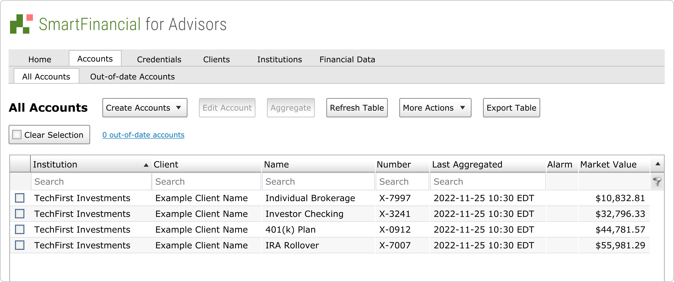
Open Banking Aggregation Account Setup Workflow
Below is an image of TechFirst Investment accounts connected successfully to the TechFirst Investment website connection, prior to the migration to the TechFirst Investments open banking API.

Slide 14
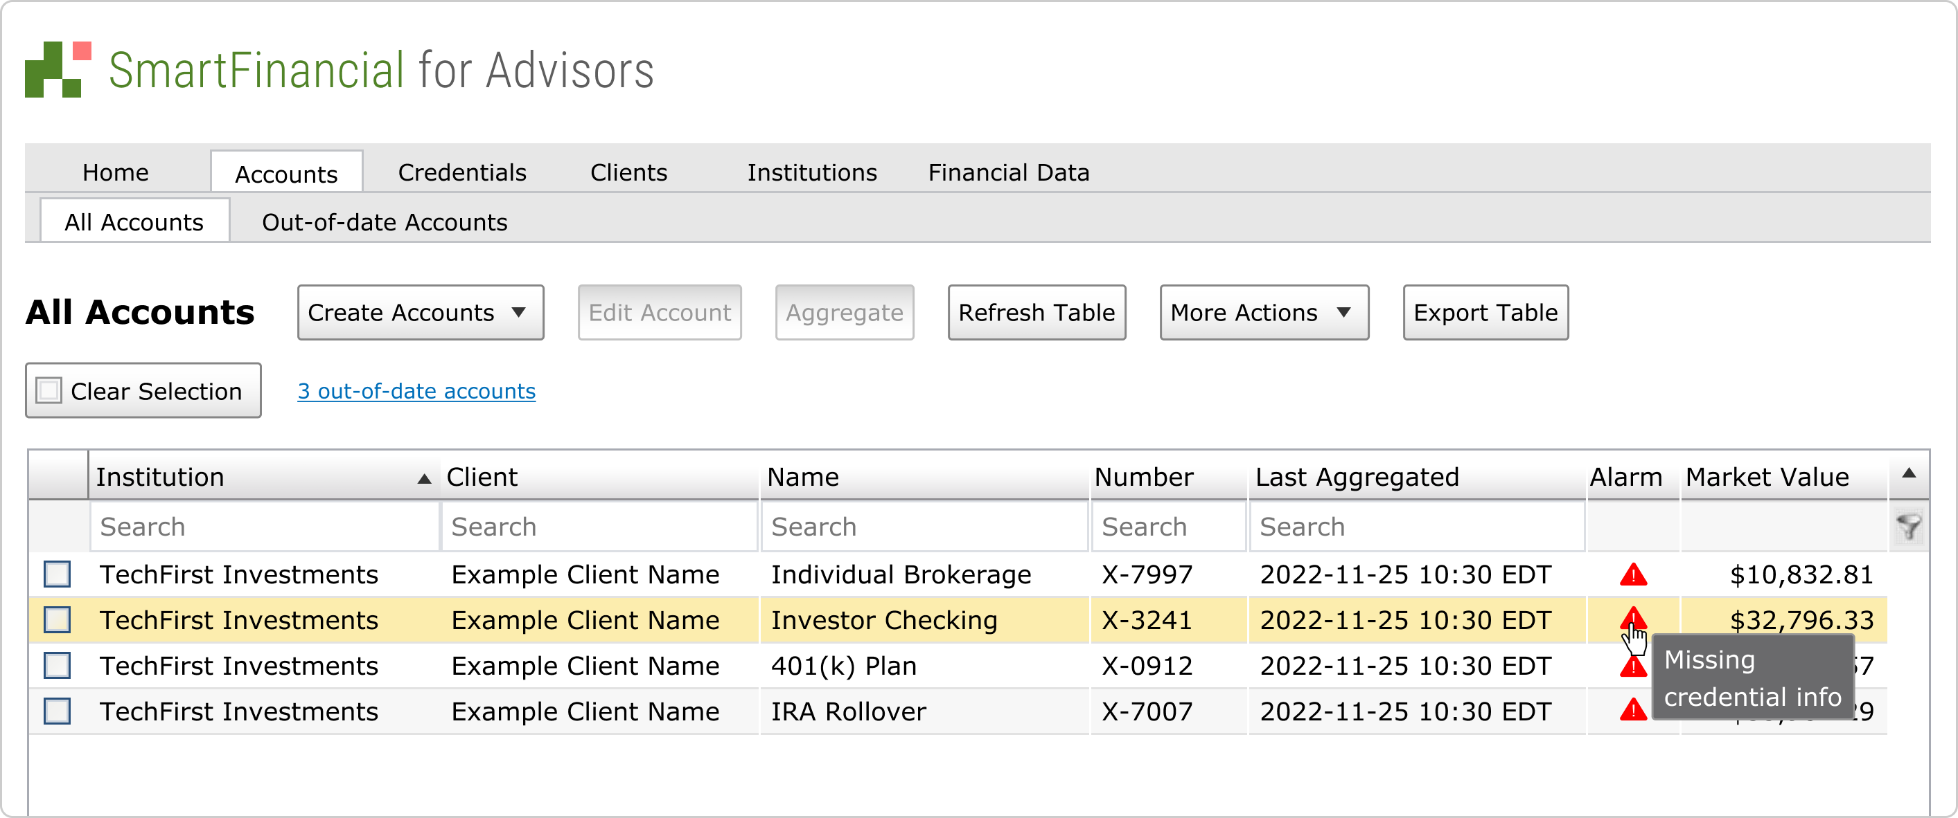
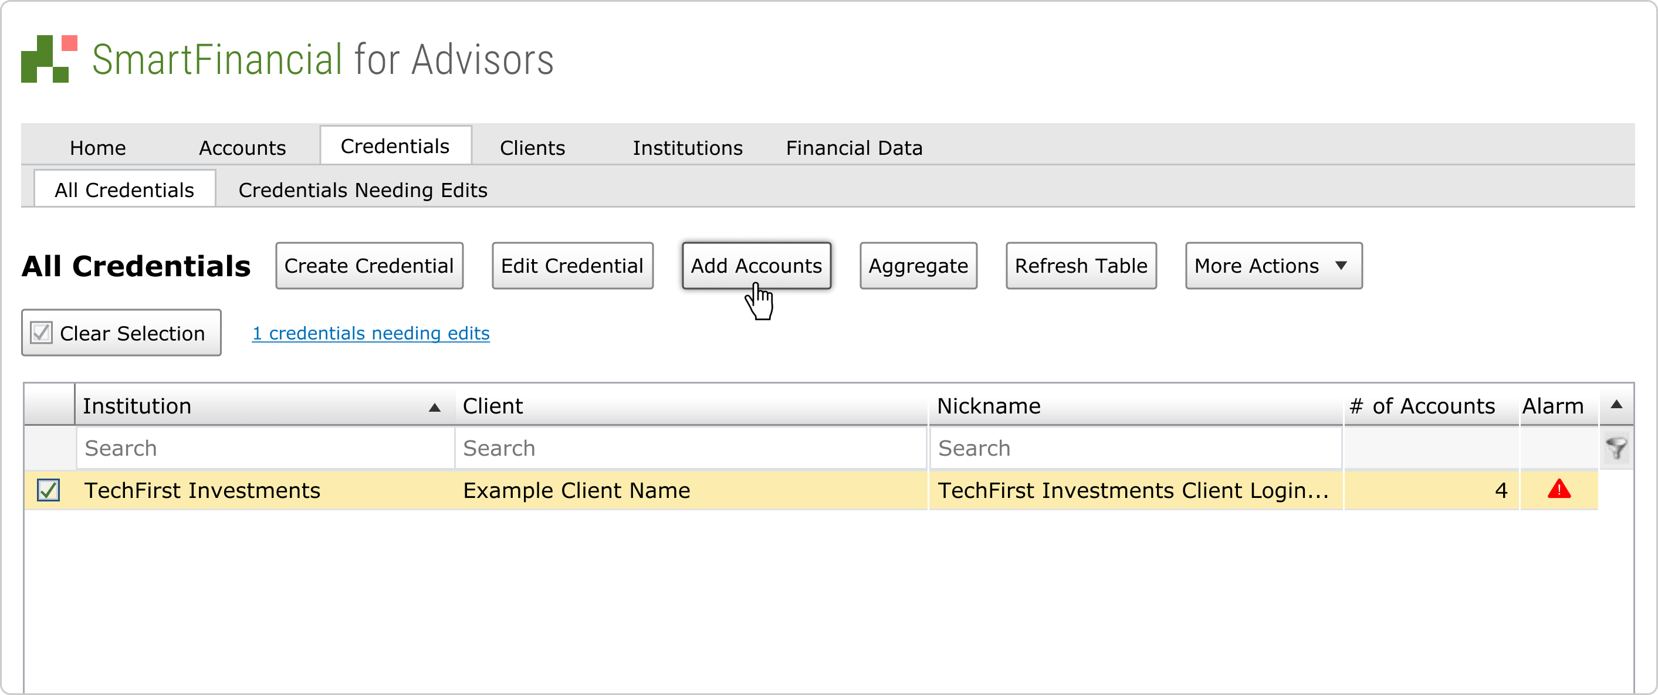
Open Banking Aggregation Account Setup Workflow
When a migration executes, you should expect to see the name of the Institution change to our new open banking API connection, and you should also expect to see both the Credential and Accounts display alarms indicating “missing credential info.” These can be seen in the images below. You will be provided advanced notice before migrations take place.
Accounts:
Credentials:

Slide 15
Open Banking Aggregation Account Setup Workflow
In order to resume the aggregation of these accounts, or authorize any new accounts for aggregation, you must complete the open banking authorization. It is important to initiate the authorization process as outlined below, as upon our initial aggregation from the open banking connection, we will map the existing accounts (previously aggregating via the web connect), which retains all account identification and history. We will also discover any newly authorized accounts. These two operations will only happen if you initiate this process via the Add Account operation detailed below. Step 1: Navigate to the Credentials Tab and select the Migrated Credential. Step 2: Once one (1) migrated credential is selected, click Add Accounts

Slide 16
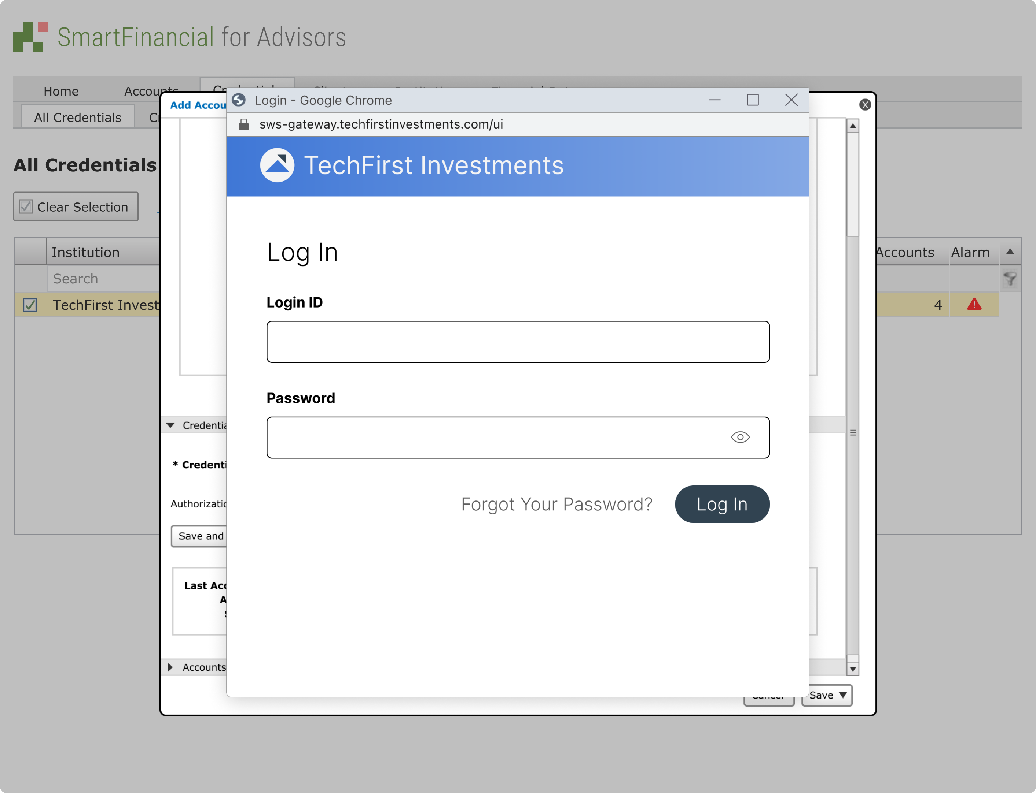
Open Banking Aggregation Account Setup Workflow
Step 3: After selecting Add Accounts, a window to the financial institution’s login page will be displayed. You must login to the financial institution in order to accept terms and conditions and complete authorization:

Slide 17
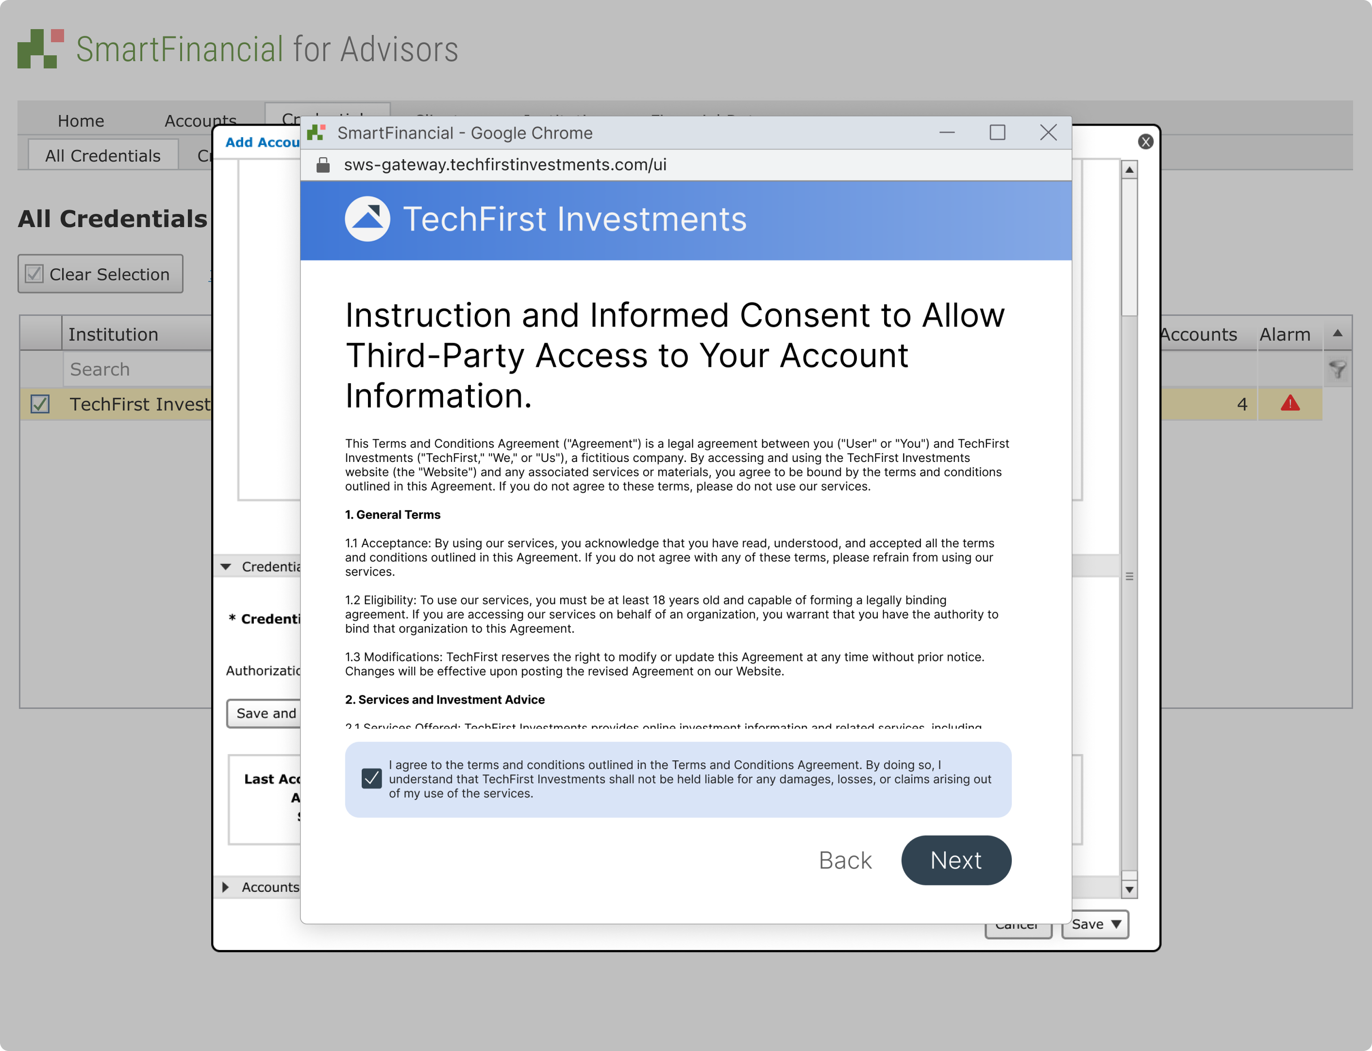
Open Banking Aggregation Account Setup Workflow
Accept Terms and Conditions:

Slide 18
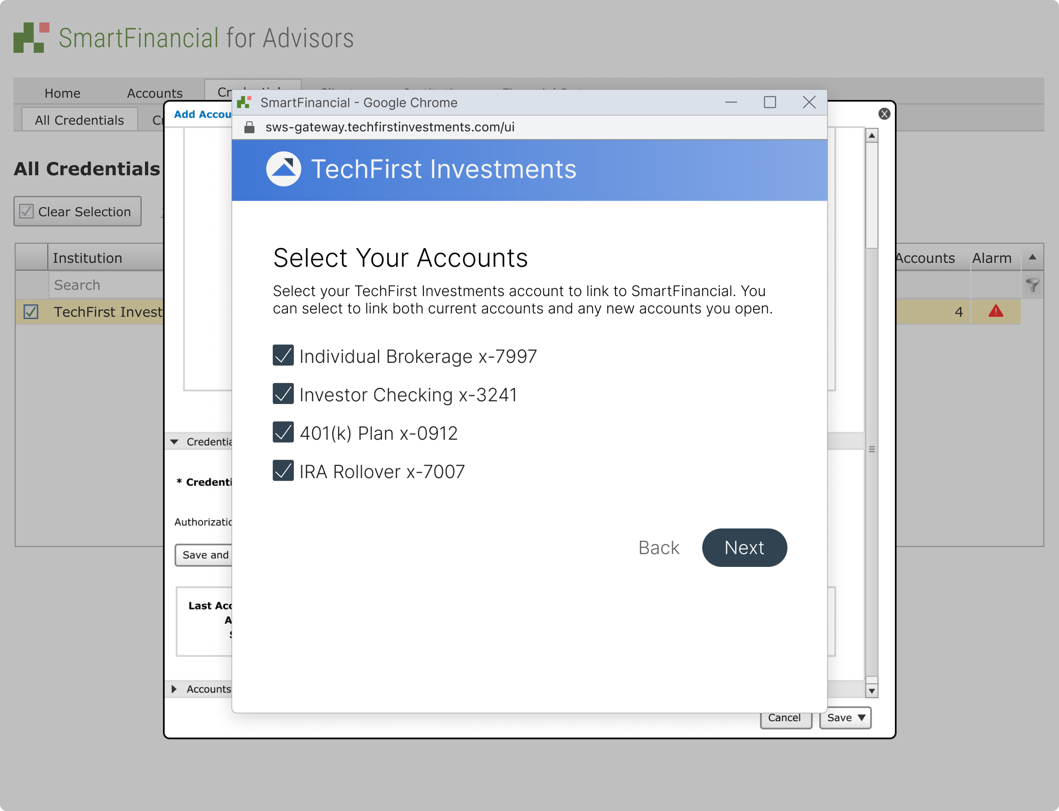
Open Banking Aggregation Account Setup Workflow
Here, the user selects the accounts they wish to aggregate:

Slide 19
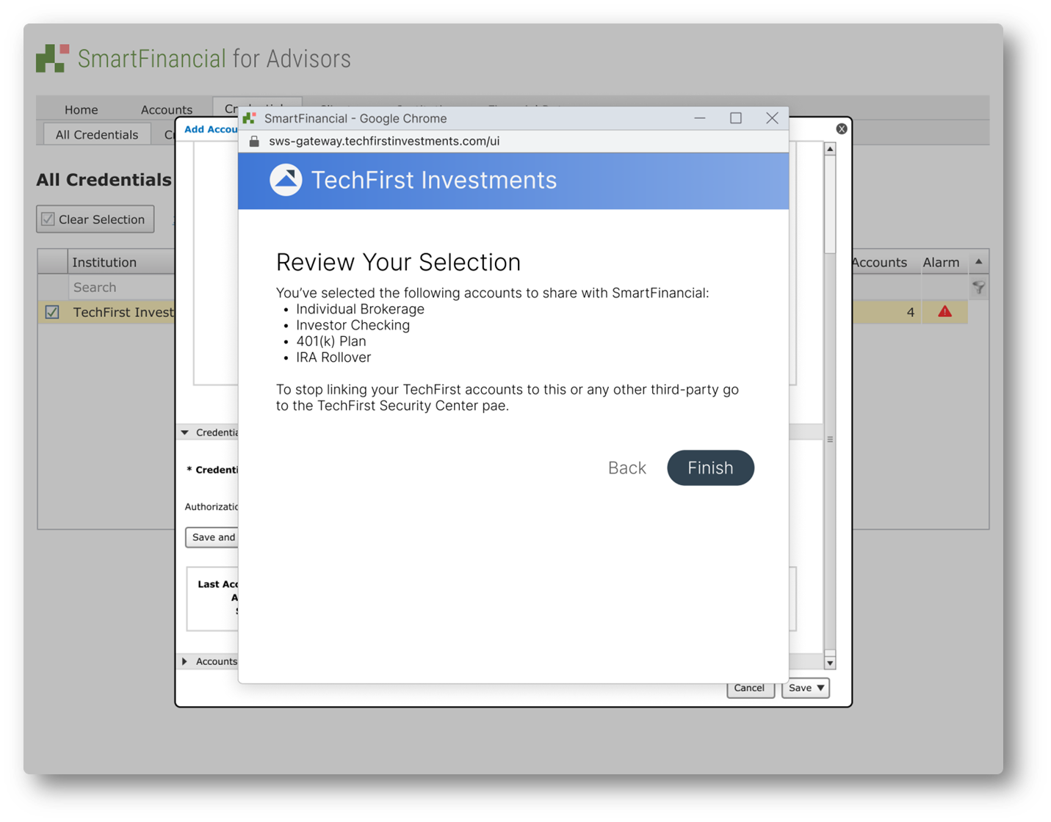
Open Banking Aggregation Account Setup Workflow
Users are asked to review their selection and click finish, then return to the aggregation application.

Slide 20
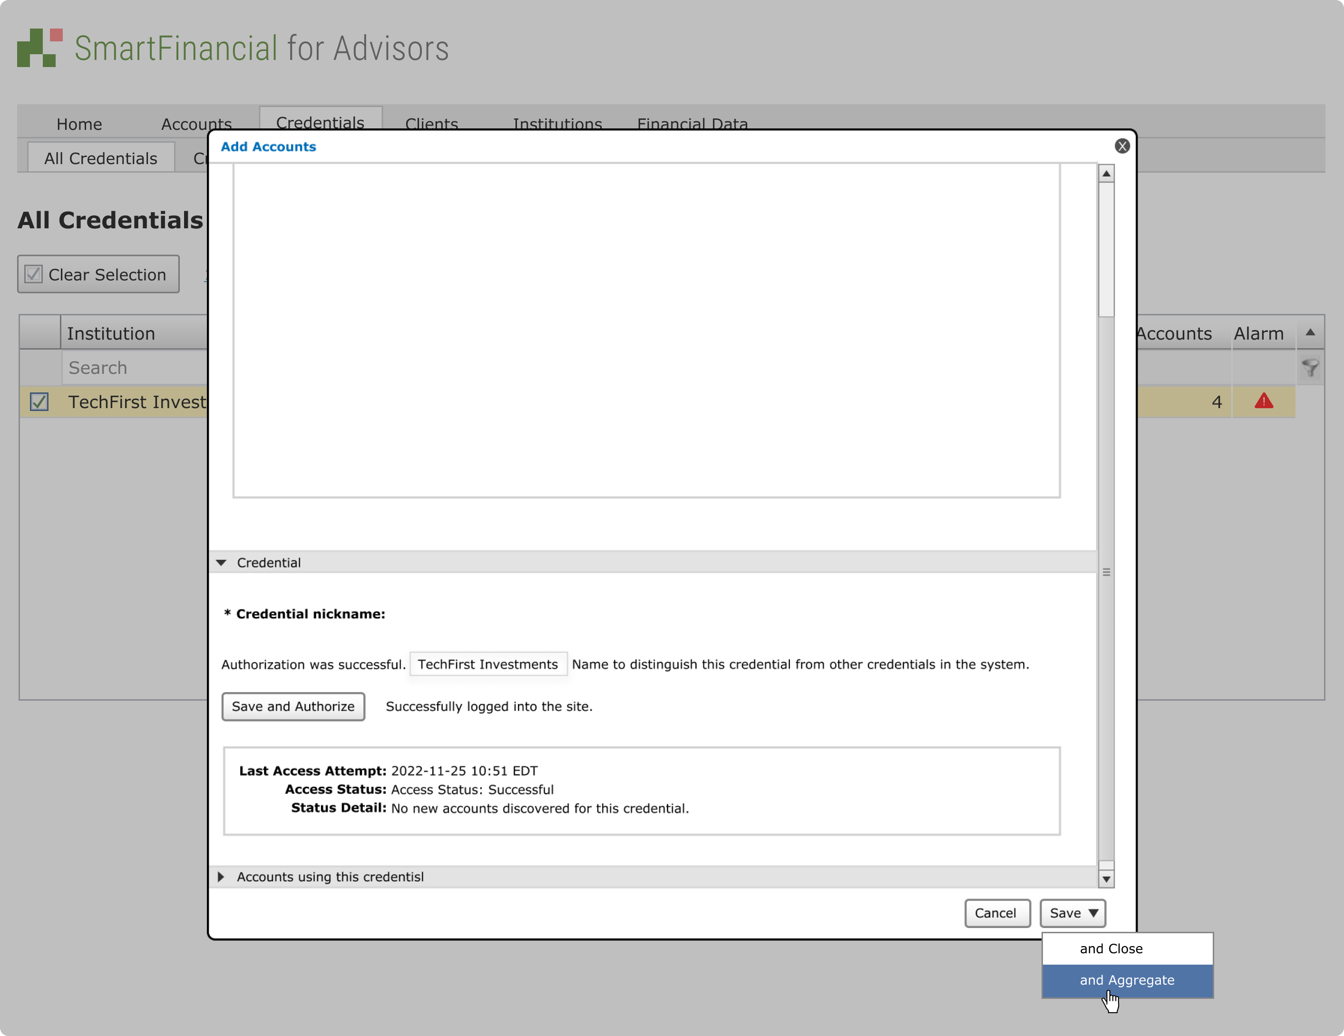
Open Banking Aggregation Account Setup Workflow
The user is then returned to the aggregation application where the accounts will complete aggregation
If you chose to authorize new accounts, you would see those accounts listed here.

